Slide 1
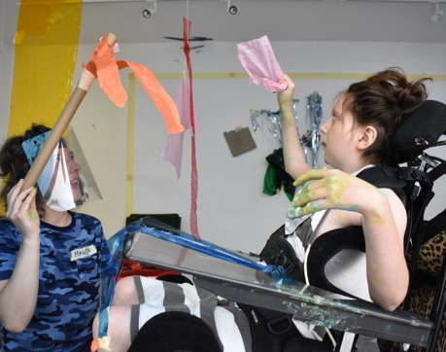
Impact Report 2021/22
Art Breaks is so much more than Art in its traditional form. It is about freedom of expression and experiences. It is about inclusion at the highest level, where it has moved on from ‘fitting in’ to ‘joining in’ and a freedom to just be.
Parent, July 2020

Slide 2
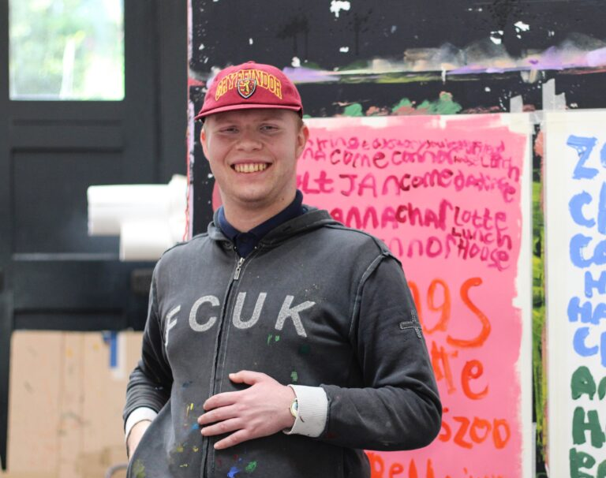
Project Art Works collaborates with children, young people, and adults with complex support needs, and their families and circles of support.
Our practice intersects art and care, responding to neurodivergence, its gifts and impacts. Challenging paradigms of inclusion, it spans direct practical and holistic support, film, events, projects and exhibitions.
Our studios provide the conditions for a broad range of autonomous and collaborative practices with neurodivergent people, who take part on their own terms.
Alongside the studios, the Support Collective brings together people who care for people with complex support needs where we share our experience and protect our rights through training, resources and advocacy.
Human connection and what it reveals about identity and how we view each other are explored within our work. Our practice continues to respond to the functional and ethical structures of diligence and care, respecting self-determination and privacy whilst working towards greater visibility and understanding of neurodiversity in culture.
Project Art Works is an Arts Council England National Portfolio Organisation and was nominated for the Turner Prize in 2021.

Slide 3
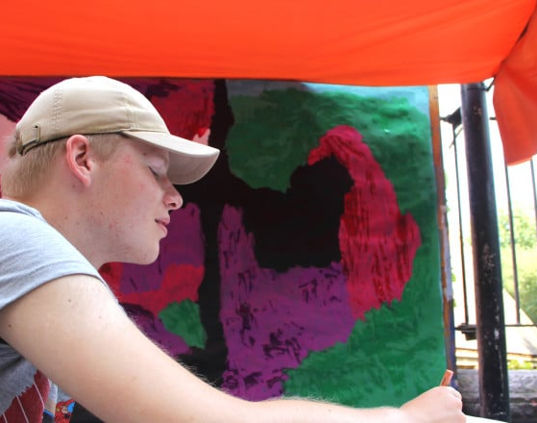
Our approach
Art Breaks is facilitated by experienced artists using Positive Behaviour Support and Intensive Interaction methodologies to support the child to make their own choices so that they lead the creative process.
If the child or young person has does not communicate verbally, we work with non-verbal indicators of assent/dissent such as eye movement, expression, sounds, to understand how they would like to interact with each activity, materials, or colours.
We build the conditions that enable participation on your own terms.

Slide 4
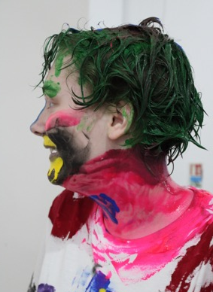
Art Breaks is an innovative project that focuses on children and young people with complex needs, alongside their parents, carers and peers.
Across school holidays and weekends, we offer a series of high-quality creative workshops giving children the opportunity to work in collaboration with a team of skilled professional artists and to experience art as a tool for exploration, communication and self-expression.
Our programme supports children and young people towards greater communication, self-expression and community integration.
We use personalised approaches to explore the potential of people with complex needs and those that support them.

Slide 5
In 2021/22, 82 children and young people with SEND aged between 10-19 participated in Art Breaks.

Slide 6
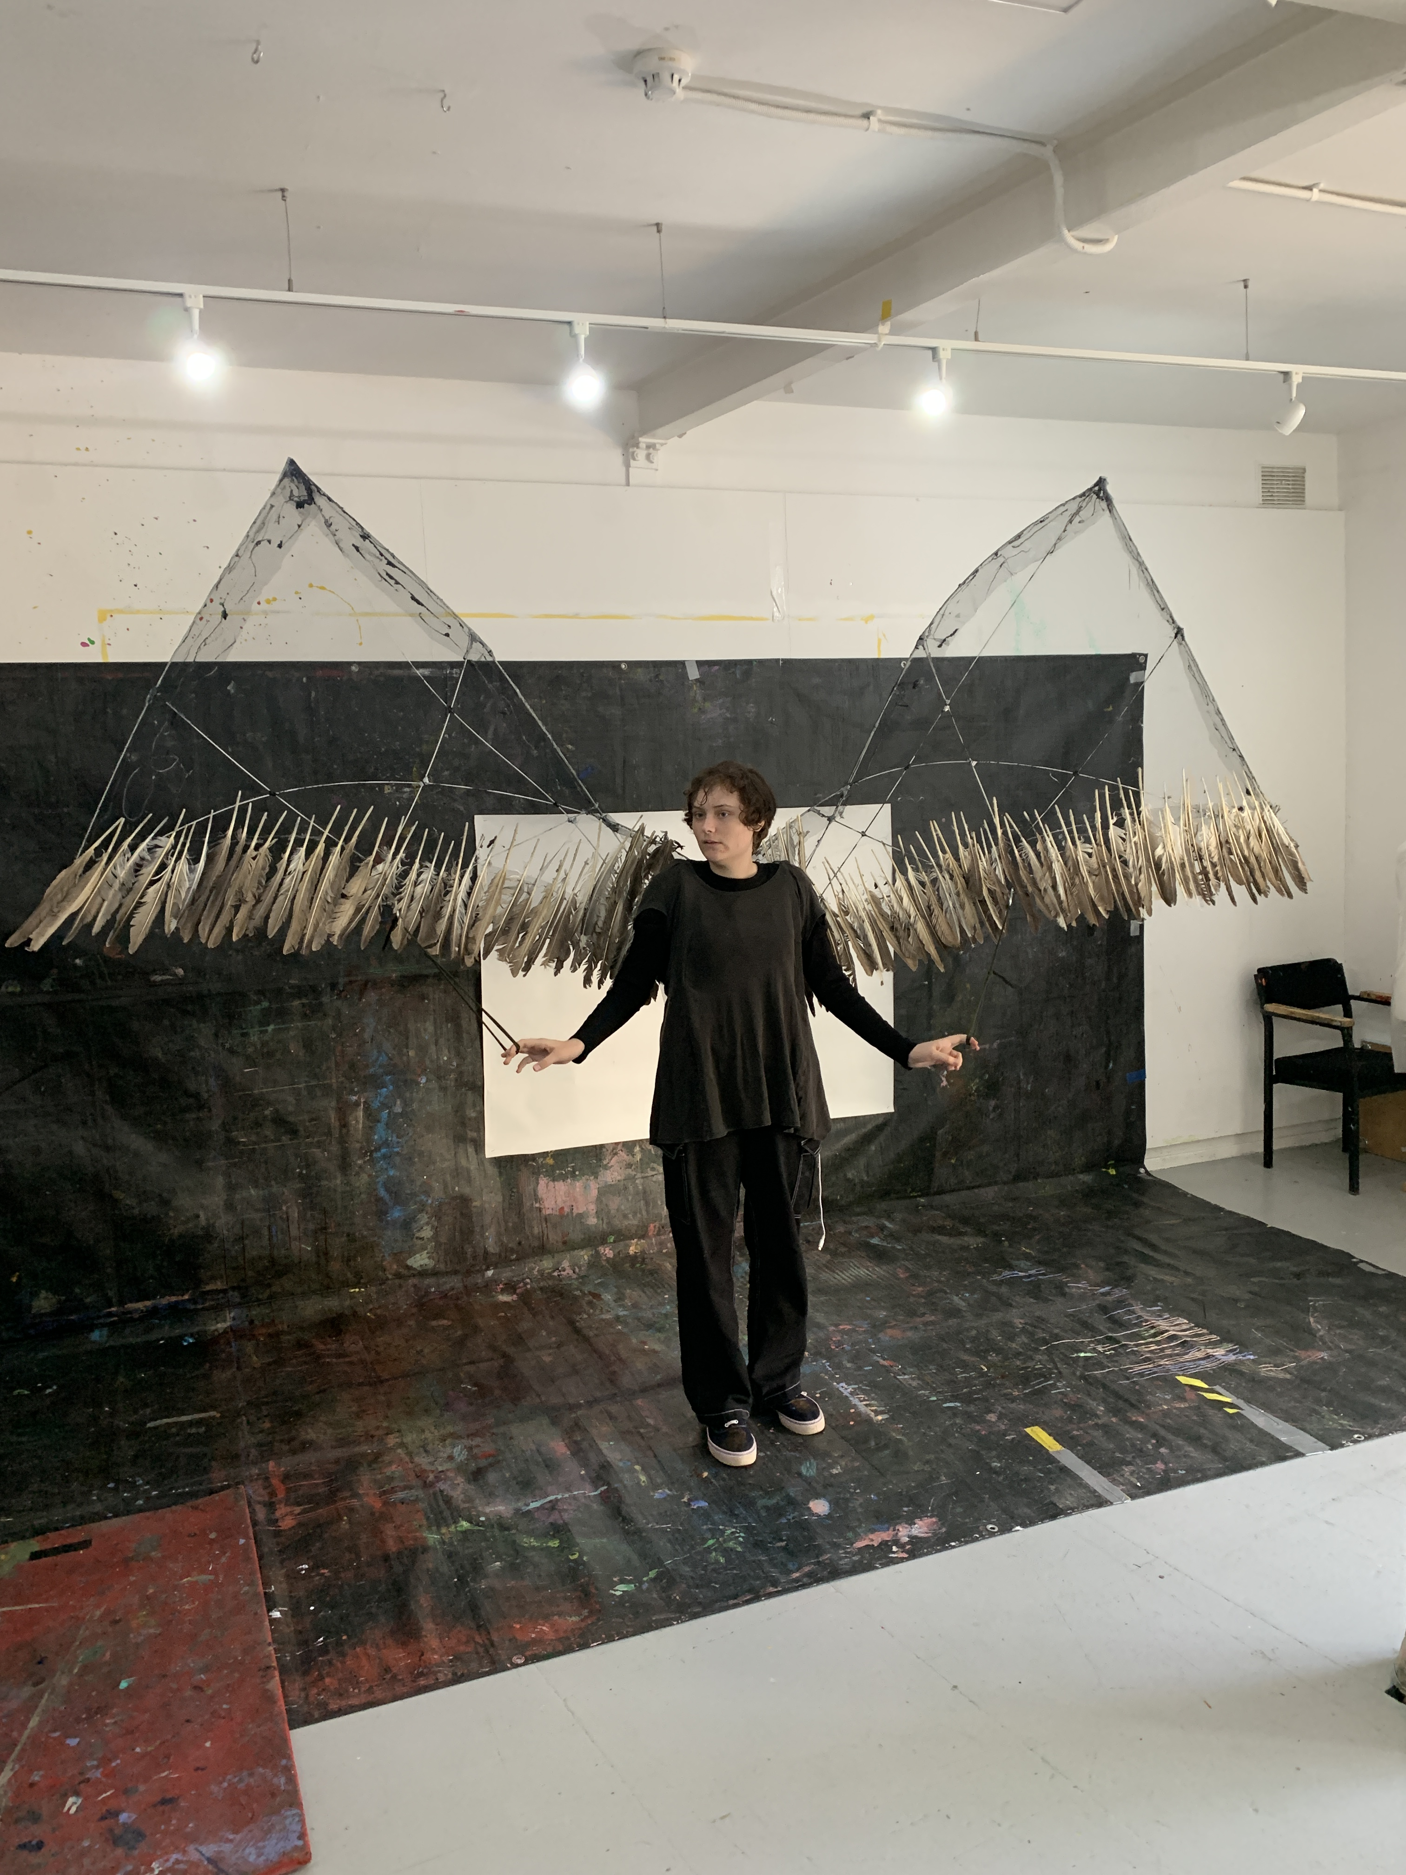
Art Breaks works with
Children and young people participating in the programme are aged between 4-19 years old.
They have a wide range of disability, some having multiple conditions including:
Autism, ASD, Dyspraxia, Pathological demand avoidance, Chromosomal abnormality, Down syndrome, IP36 Deletion syndrome, Chromosome 69 Deletion syndrome, Dyspraxia, Angelman syndrome, Sensory processing disorder, focal cortical dysplasia, hypermobility, DDX3X syndrome, quadraplegic, Telangiectasia, OCD, Cerebral Palsy, Tourette syndrome & Phelan McDermid syndrome.

Slide 7
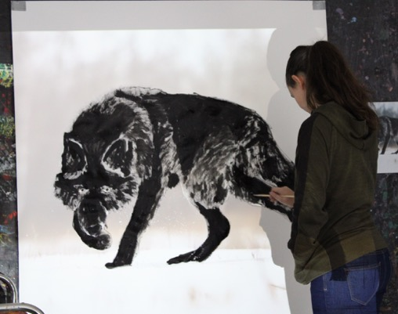
Art Breaks provides positive creative opportunities at weekends and holidays for children and young people aged 5-19 with disabilities and their families in East Sussex.
Art Breaks improves relationships in the family group, improves practical and cognitive skills, provides opportunity for self-expression and agency, strengthens communication skills, and reduces anxiety.
The project is formed of two distinct but interconnected strands:
Saturday workshops: piloted two years ago the workshops have proved to be a vital resource for children and their families. Developed to reach out to young people with the highest support needs, we work with a family group over a period of four consecutive Saturdays to build confidence and develop new ideas and fresh approaches, enabling parents to explore new ways of connecting. For some this will provide a stepping-stone to engage for a long period through the holiday provision.
Holiday workshops: provides support through the summer and in the winter holidays where there is little opportunity particularly by those with additional health needs to explore outside.
Within the workshops children with a broad range of support needs, including profound and complex disabilities, shape and control the environment, and are supported to participate by highly skilled artists who facilitate using communication outside of conventional language and tailored to those with sensory impairments.

Slide 8
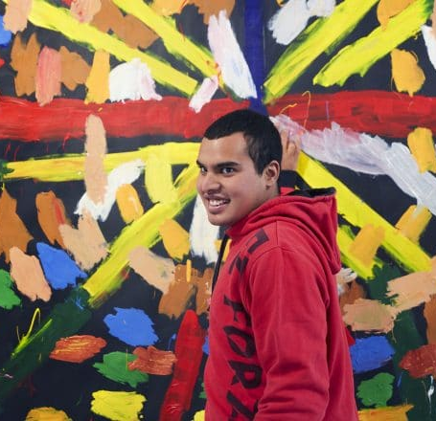
Case study
Project Art Works has a long track record of working with people in crisis, with children and young people with these kind of support needs who now regularly participating in creative practice in our studios, and how the individuals are perceived is changed.
Our approach is to change the environment and provide the materials, rather than impose an expectation on the individual. Children and young people with SEND choose how they want to participate and there is no set timescale for them to engage. We work more directly with the family so that they can access peer support, advocacy, legal advice, specialist training, counselling, and start to plan for the future with hope.
Siddharth was first introduced to Project Art Works in 2017 by his parents when he was a teenager. Living 45 miles away from Hastings, they had not been able to find any suitable services and Siddarth was not in education and living in residential care. He has profound and multiple learning disabilities including autism, behaviour described as challenging, and is non-verbal.
We invited Siddharth to work in the studios, adjusting the space and offering 1:1 support so that he could engage with creative activities if he chose to. Within the first session he focussed on producing large-scale paintings, working methodically and calmly for several hours.
His interactions and our methodology were observed by his mother and support workers, who had not previously witnessed Siddharth engaging in this way. Siddharth had always been defined by his support needs by services, and our approach challenged their perception of his capabilities and how they could support him to participate.
His mother joined the parents and carer programme , The Support Collective, and now regularly meets with other family carers, accesses free training and is undertaking PATH (Planning Alterative Tomorrows with Hope) which is an aspirational planning tool that we facilitate so they can plan what the future could look like for Siddharth and the steps they need to take to realise this. Siddharth’s artworks have been exhibited at the Royal Academy, in the Turner Prize 2021 show, at documenta fifteen, he had a solo exhibition in Brighton in 2019, his artwork was featured in a nationwide advertising campaign, and sells for 4 figure sums (50% of sales being returned to the family).

Slide 9
The context: Children & young people who have complex support needs and/or additional needs are some of the most excluded in society. The term 'complex needs' embraces a number of impairments such as severe learning disability and/or autism and/or communication impairments and behaviours described as challenging. They are very dependent on family carers, schools and social services to access the wider world and experiences. Many of the young people we work with are non-verbal, and use alternative means of communicating e.g. eye-contact, movement, sound, gesture, behaviour, so visual art can be an effective tool for connection and an alternative way to communicate. The continuation of cuts to social care and the reduction in community based provision and thereby opportunities for short breaks, is directly impacting on the lives of children with complex needs and brings additional stress and challenges to family life. This reductionism further isolates them from society and opportunities to build a network of support. East Sussex sits in the top 20 indices for multiple deprivation, and Hastings is the 13th most deprived local council area in England. The day to day support required by young people with complex needs often means parents or carers are unable to work, further limiting choice.

Slide 10
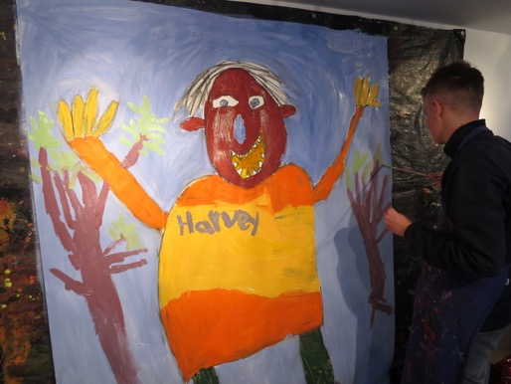
Evaluation
We monitor and evaluate Art Breaks through interviews, observation, recording attendance, case studies.
Participants (or carers if they lack mental capacity) complete feedback forms that monitor three areas of impact:
Strengthening relationships (73% reported a significant progress, 27% starting to experience*)
Positive empowerment and agency 47% reported a significant progress, 53% starting to experience*)
Supporting emotional wellbeing (80% reported a significant progress, 20% starting to experience*)
*2019/2020 data (feedback forms on hold during pandemic)

Slide 11
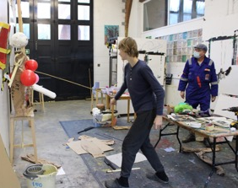
Project Aims
Create Positive Empowerment
D will take away a model which she hasn’t had to rush and has had time to feel like she has completed/accomplished it. L has produced a fabulous painting of a wolf, experimented with inks to produce a horse picture and has been supported in her taxidermy. Parent, 2020
By providing an environment where children and young people with complex needs are supported to lead the creative activity, their confidence grows. Many of the young people we work with return each year, building on their experience from previous interactions with the Project Art Works artist team. Parents delight in watching their child's independence & creativity expand.
We continue to develop relationships with schools, social care services and with children and their families who are unable to have their needs met in a school environment.

Slide 12
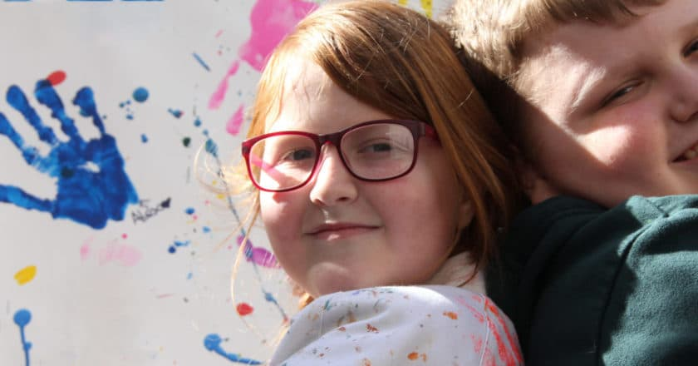
Project Aims
Strengthen relationships
‘Both children and parents delighted to be back; T & W boisterous but friendly working collaboratively and cooperatively together, parents made art too. All happy together and very pleased to be working with an artist known to them again.
Artist Facilitator, 2020
The workshops provide opportunities to support and strengthen existing relationships within the family group and connect with young people who share similar circumstances, and space for siblings and parents to connect in a safe and creative environment.

Slide 13
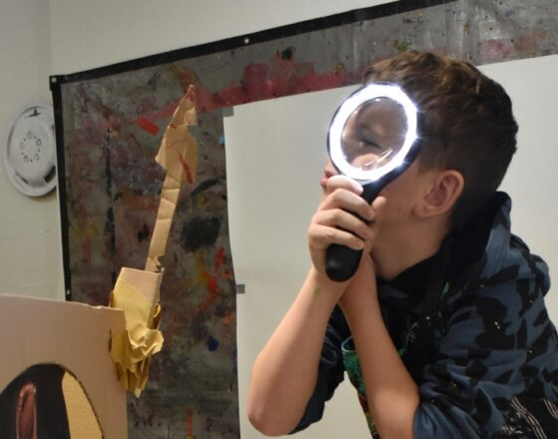
Project Aims
Support emotional wellbeing
It has made a real difference to their mental wellbeing over this second lockdown period. It had fed L’s creative spirit and encouraged her to move forward with her art rather than stuck repetitively redoing the same pictures. Parent, 2020
Many of the children and young people attending display behaviours described as challenging. By offering opportunities for the child/young person to lead their creative engagement, this reduces anxiety and allows them to feel safe, supported and confident.

Slide 14
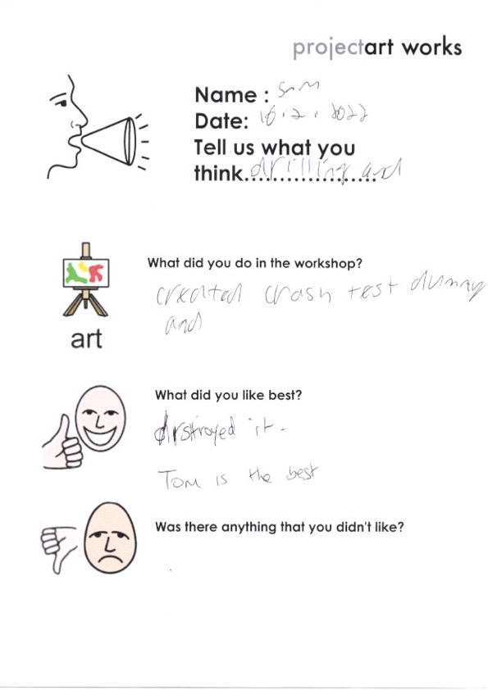
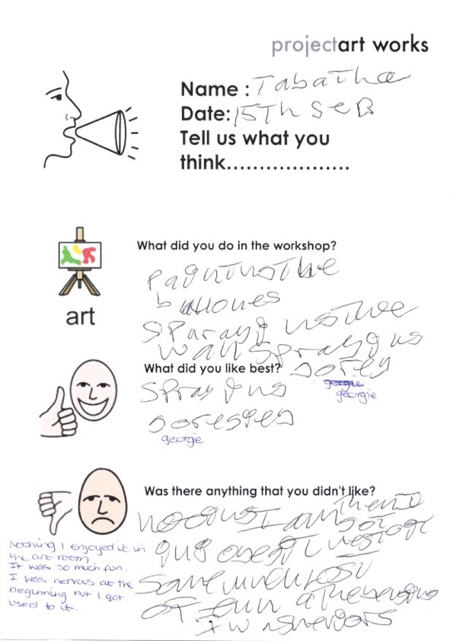
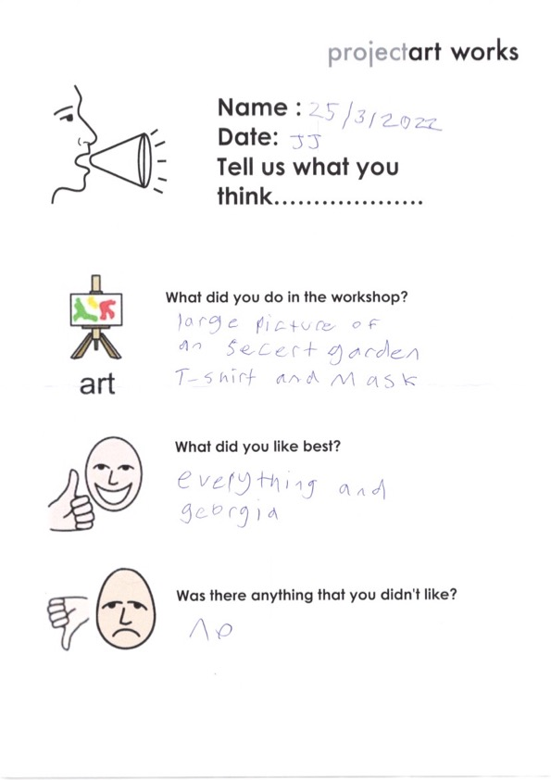
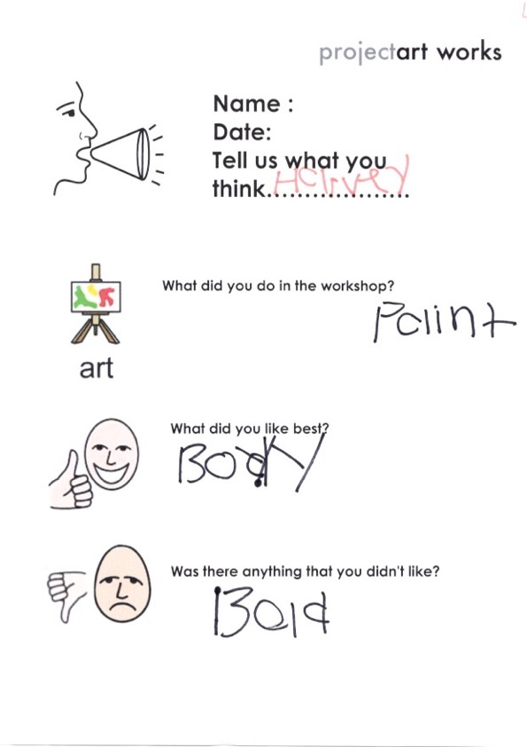
Evaluation
Easy Read feedback forms are also completed where possible by the children or young people who take part.

Slide 15
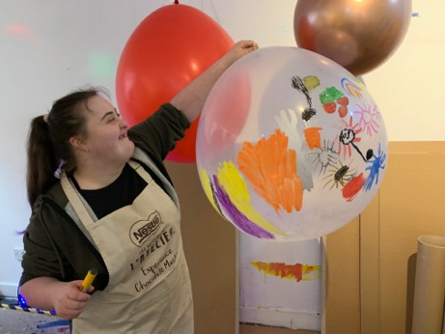
Project Art Works
Arch 3, Braybrooke Terrace, Hastings, East Sussex,
TN34 1TD
0044(0)1424 423555
www.projectartworks.org
info@projectartworks.org
Like us on Facebook
Follow us on Twitter
Follow is on Instagram

